Slide 1


Slide 2

Grazie ai nostri sponsor

Slide 3
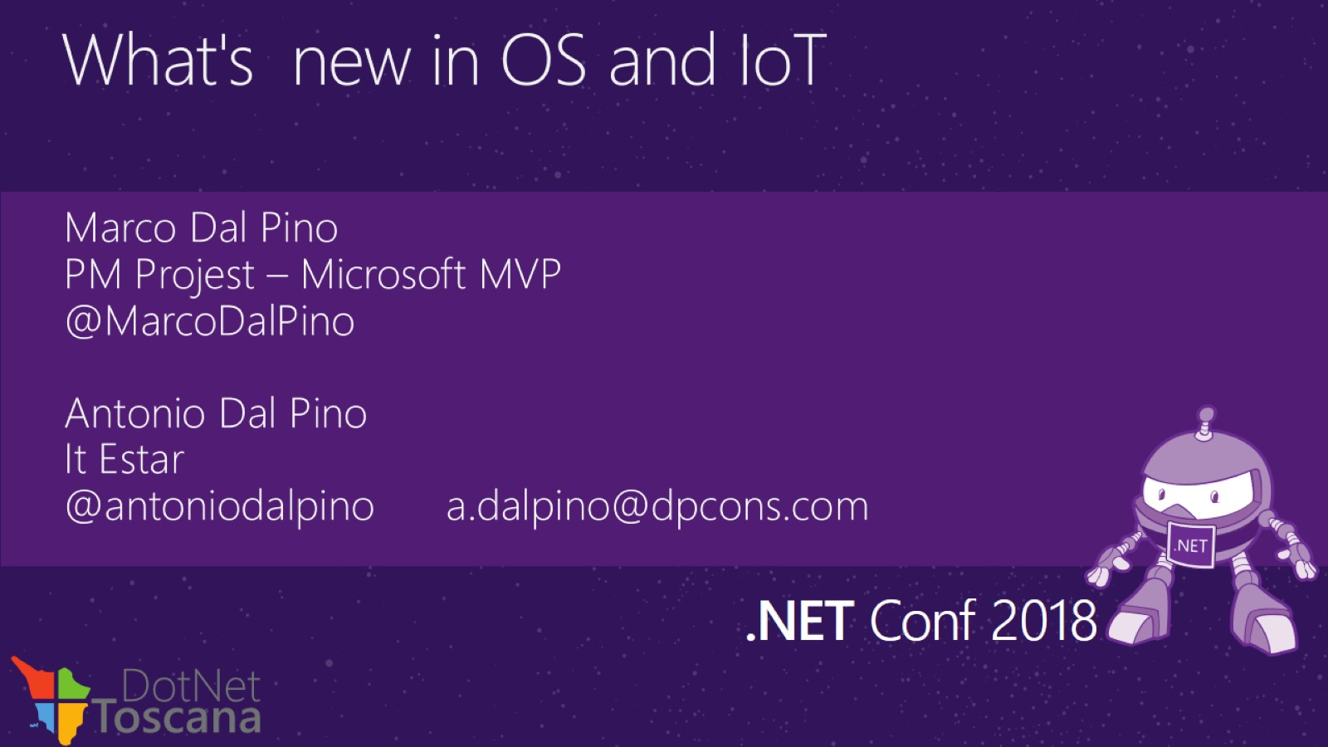
What's new in OS and IoT

Slide 4
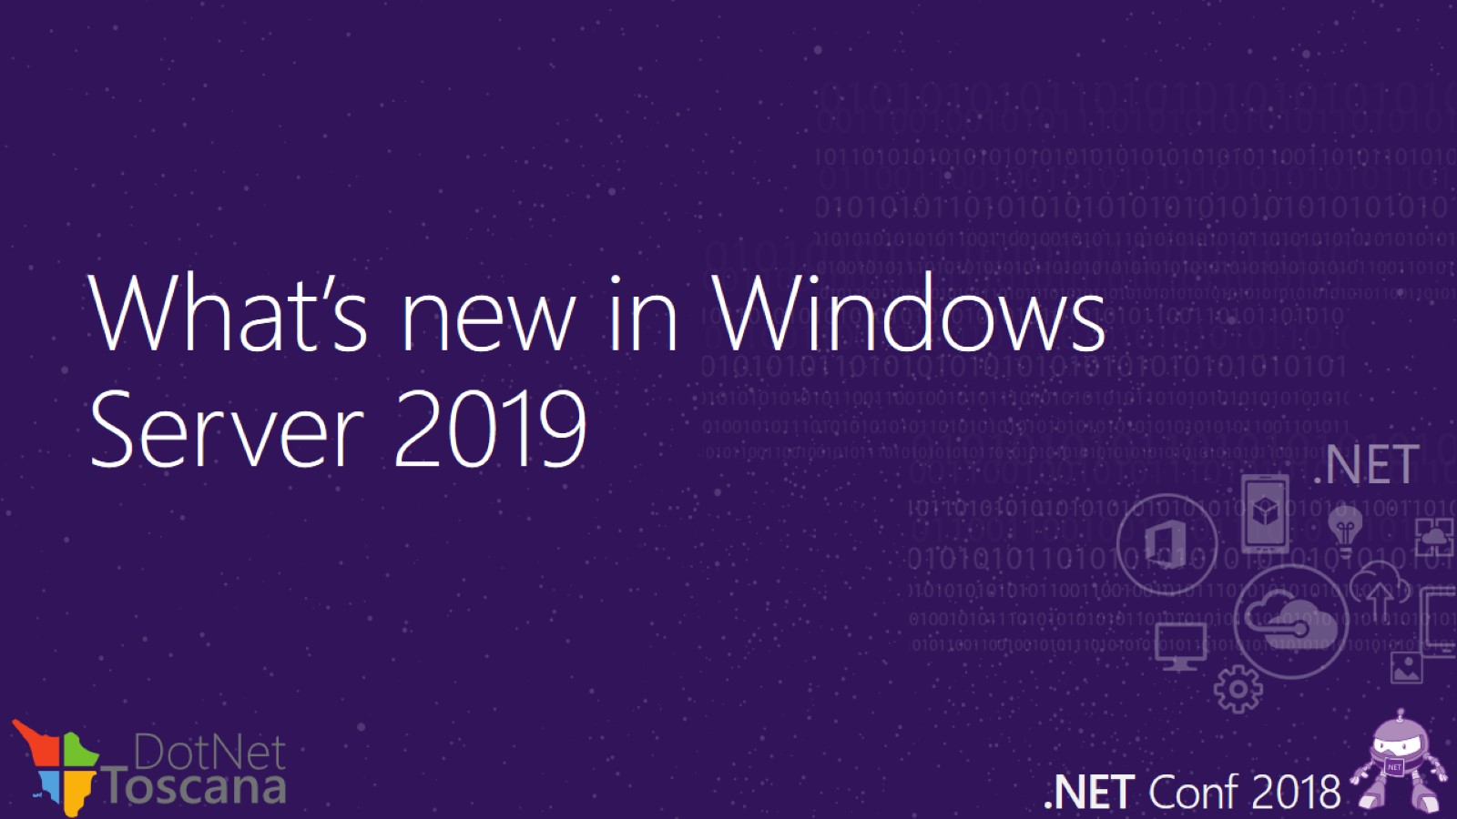
What’s new in Windows Server 2019

Slide 5
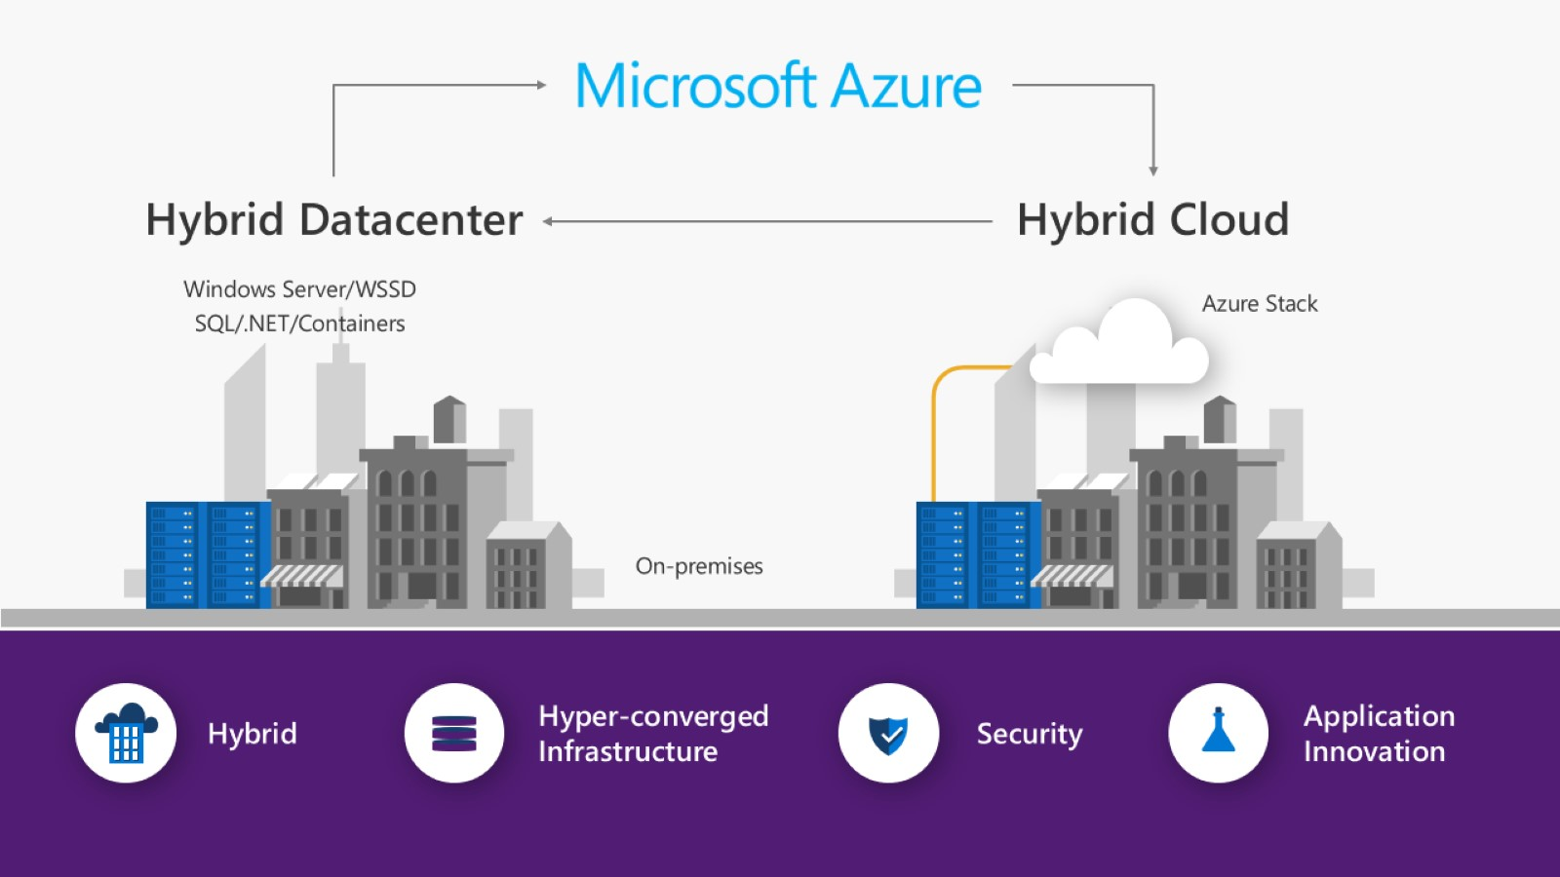

Slide 6
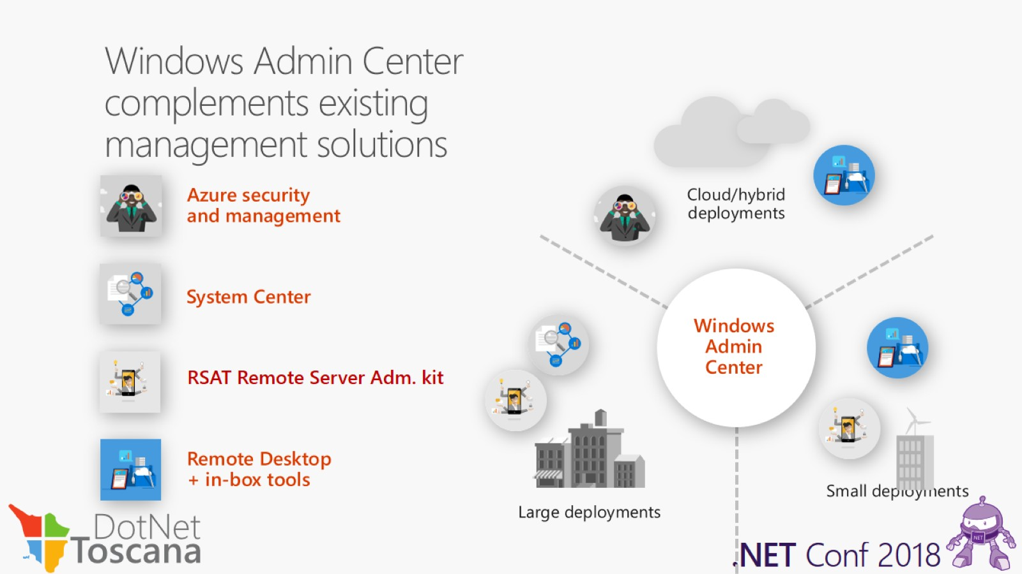

Slide 7
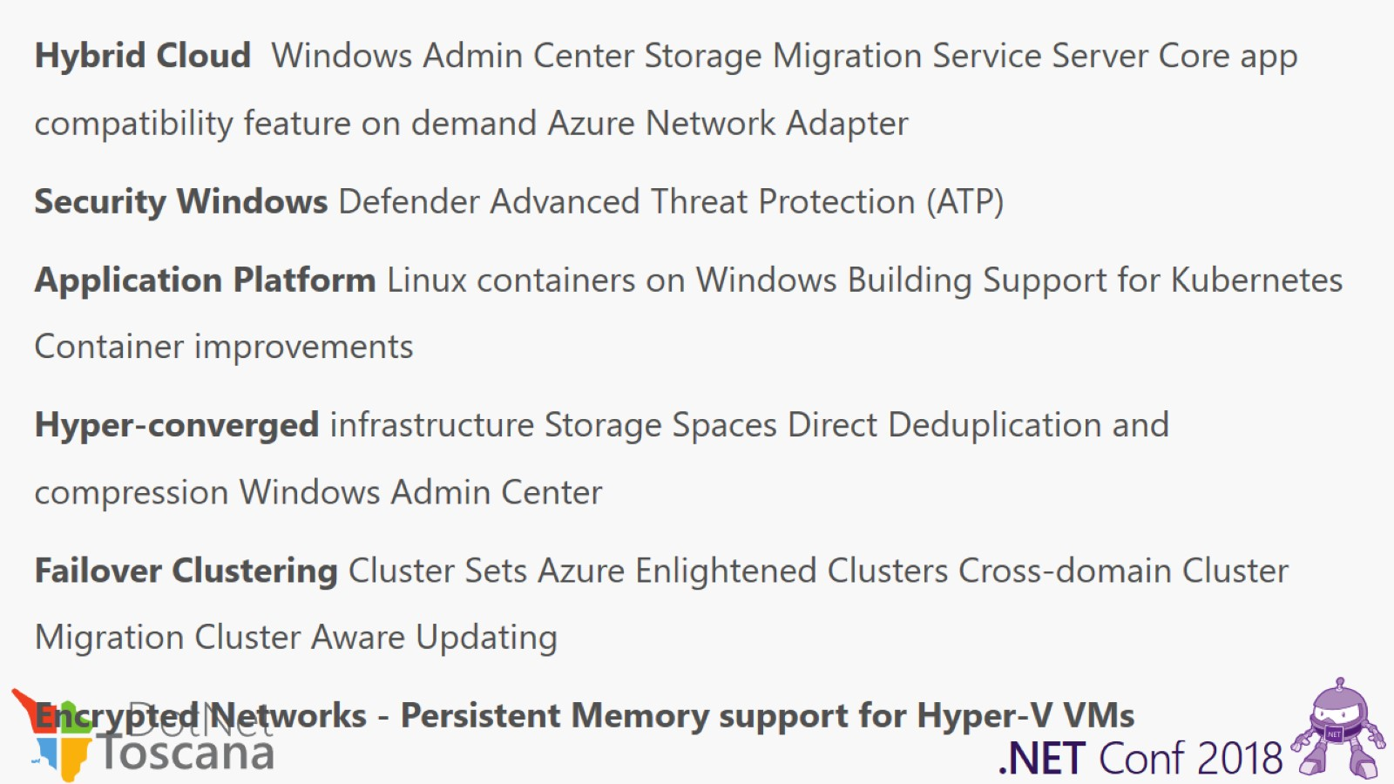

Slide 8
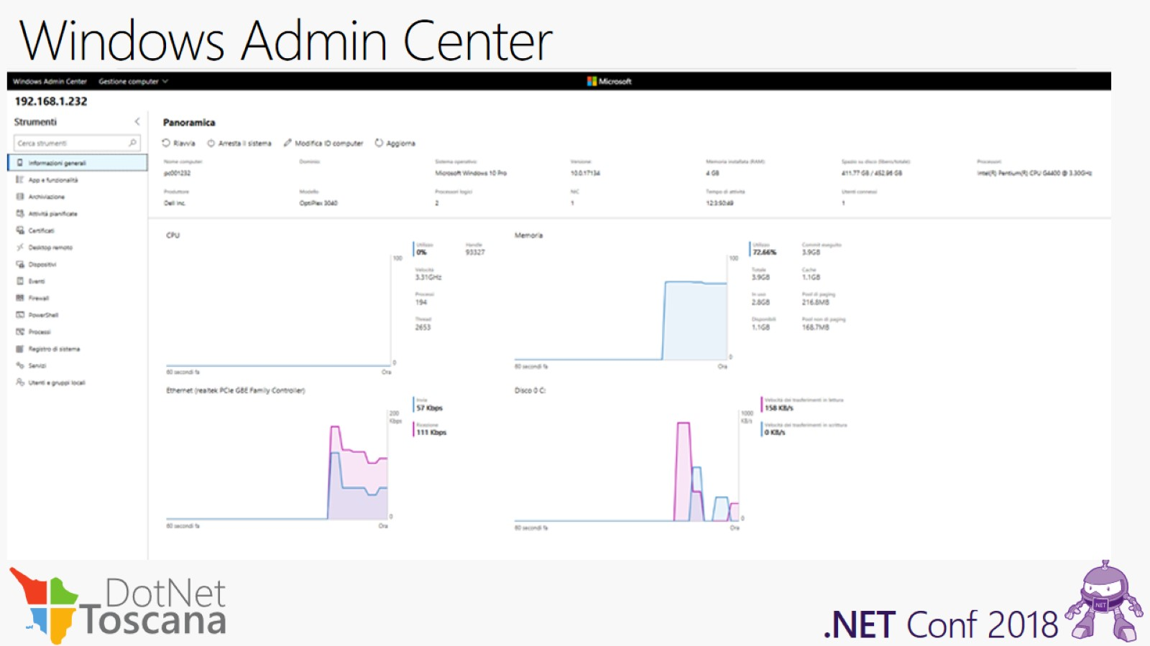
Windows Admin Center

Slide 9
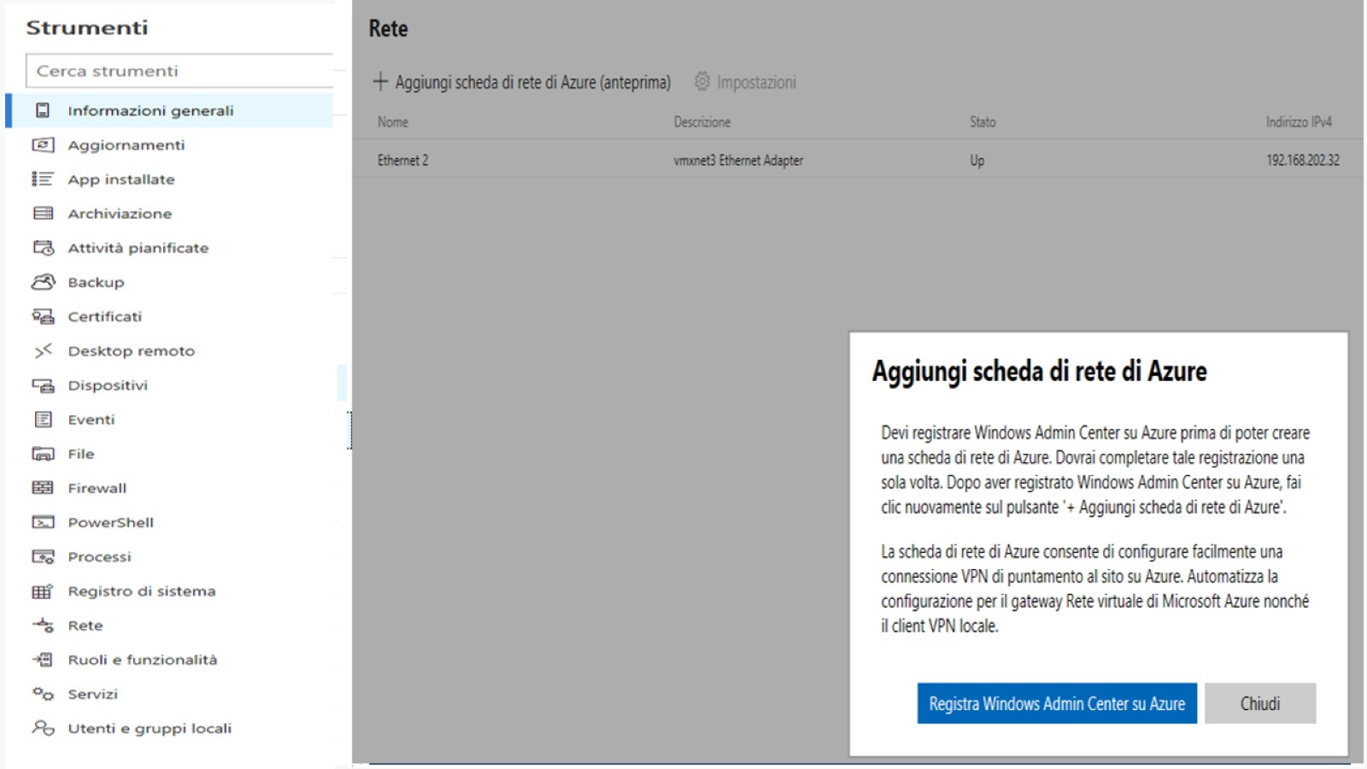
Windows Admin Center

Slide 10
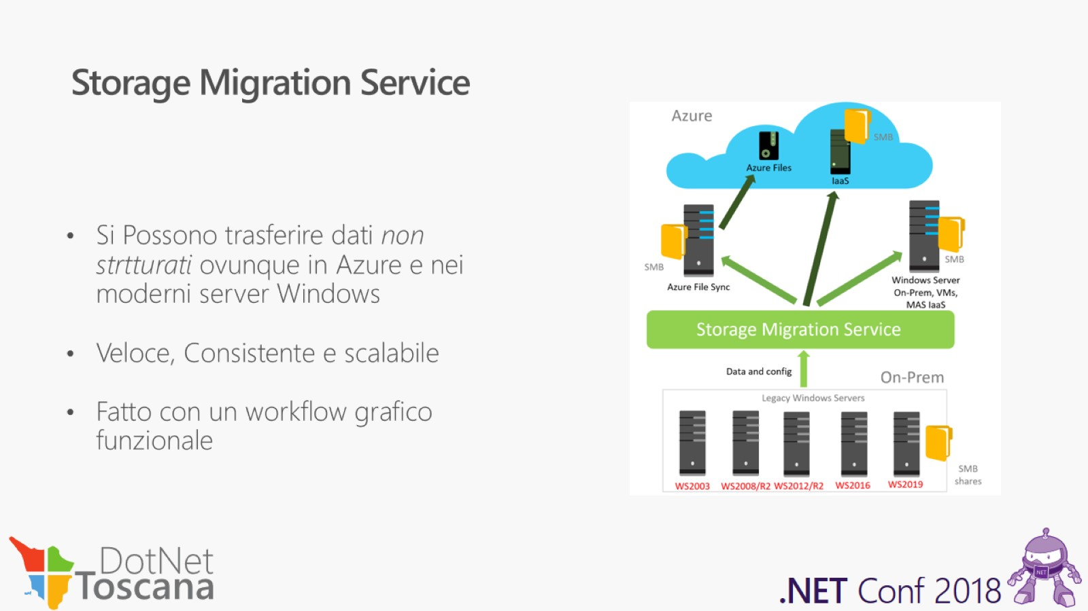
Storage Migration Service

Slide 11
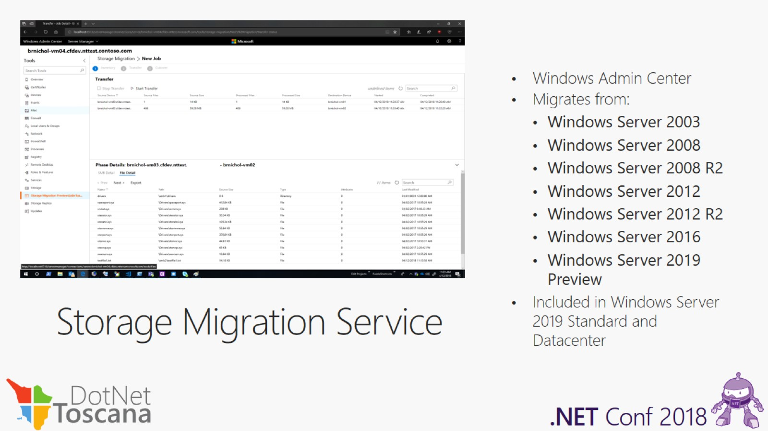

Slide 12
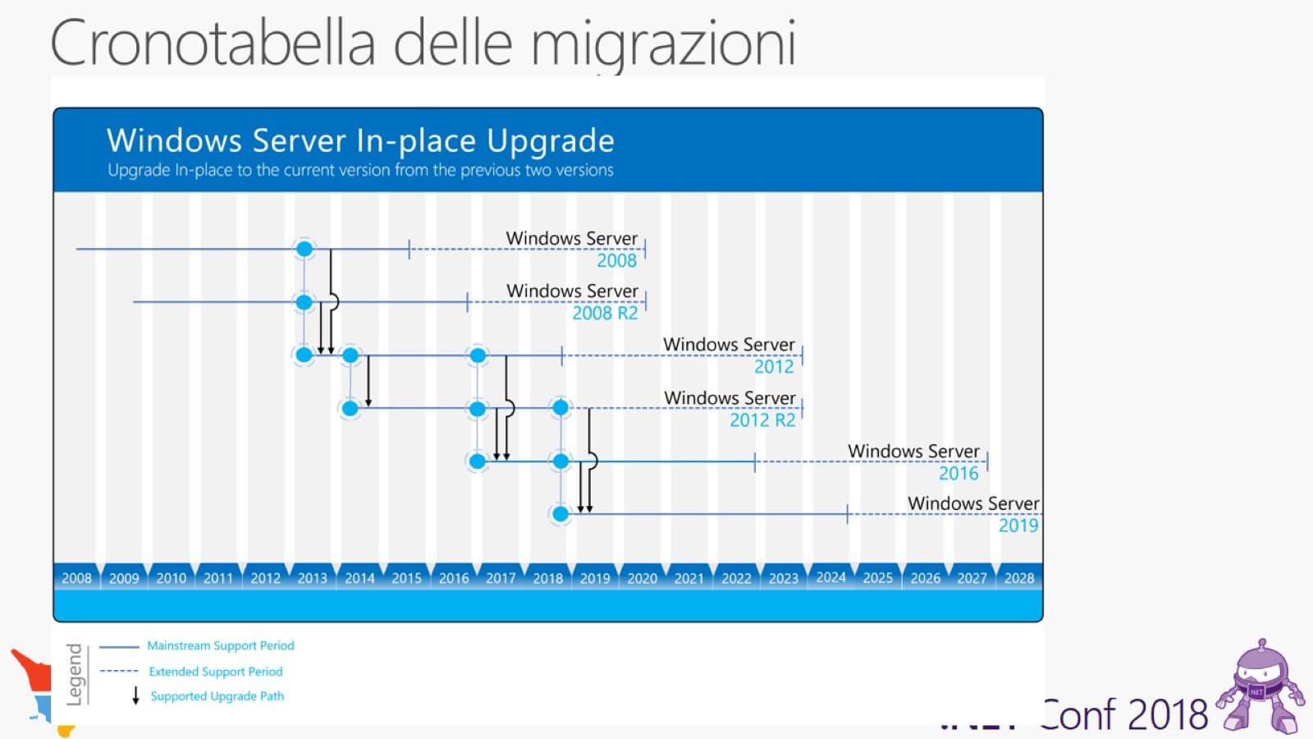
Cronotabella delle migrazioni

Slide 13
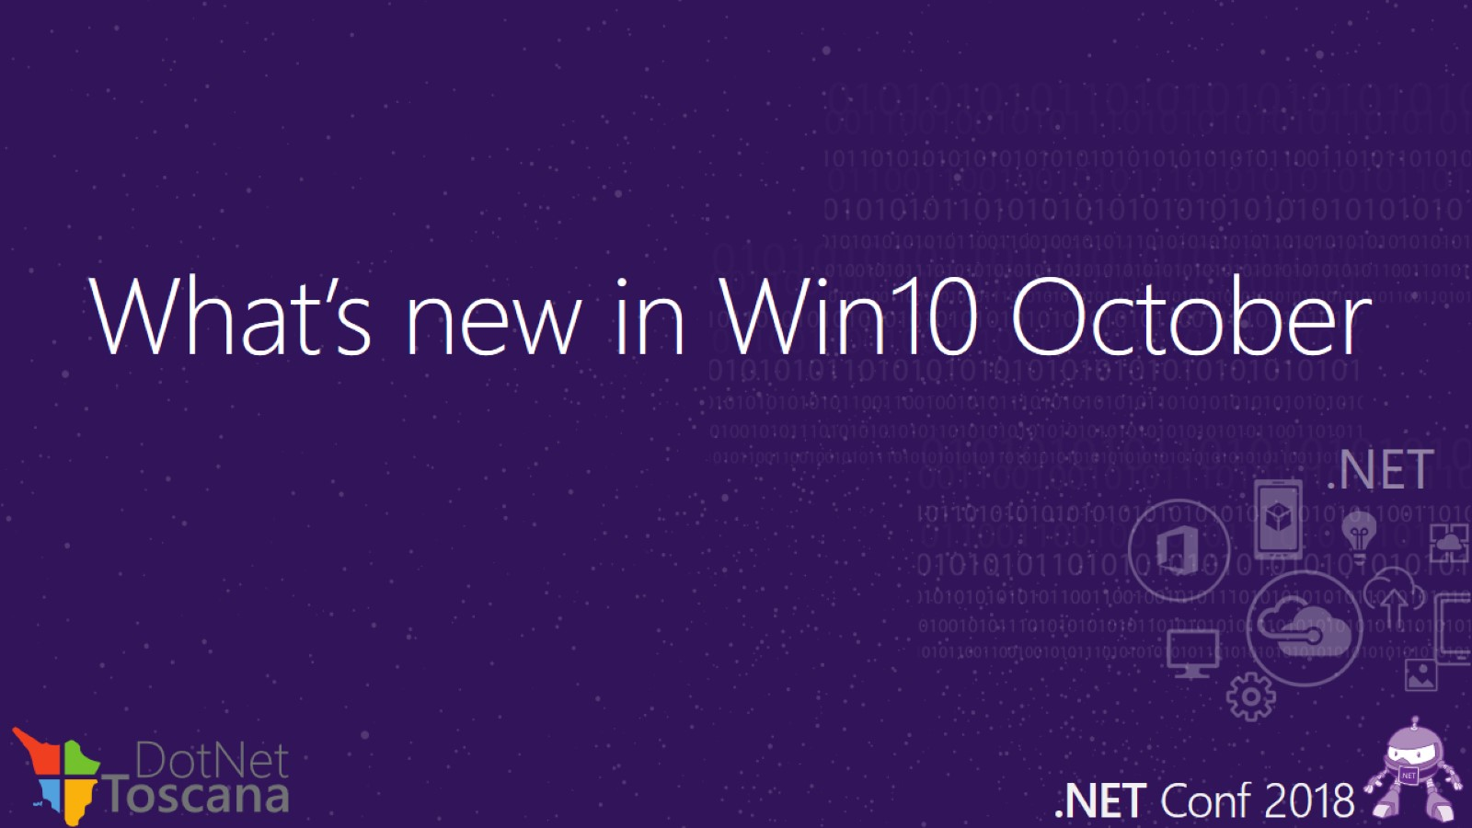
What’s new in Win10 October

Slide 14
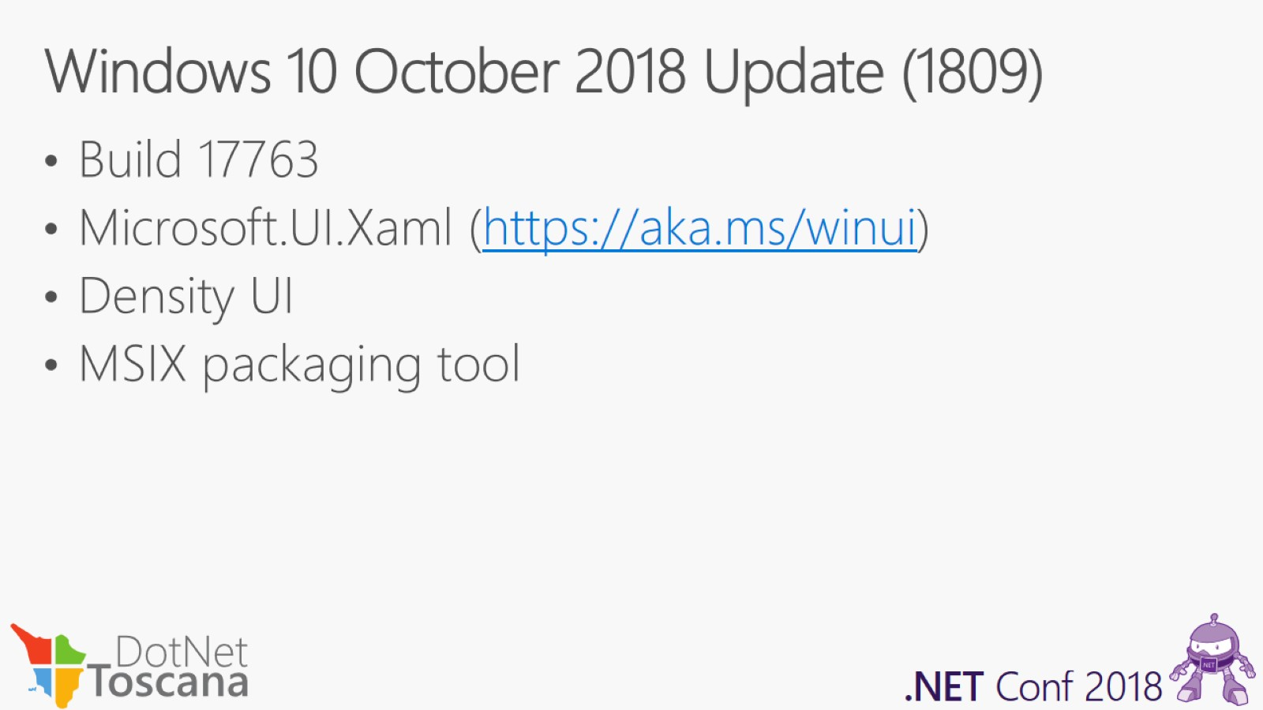
Windows 10 October 2018 Update (1809)

Slide 15
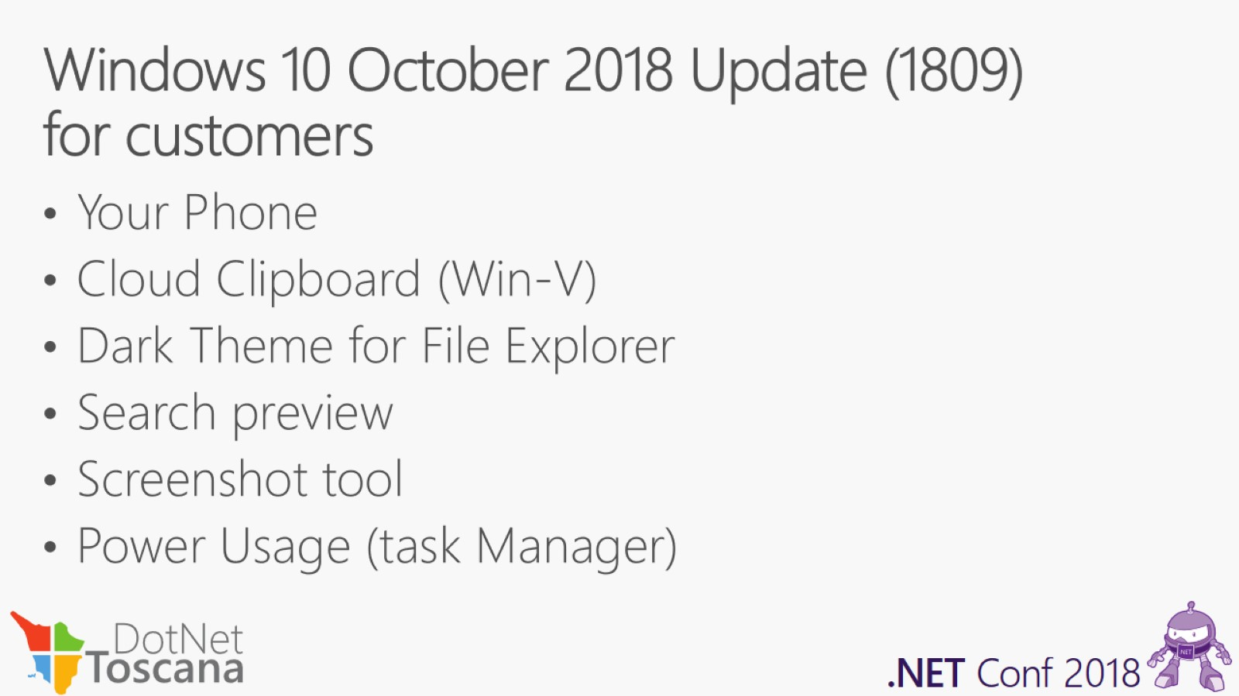
Windows 10 October 2018 Update (1809) for customers

Slide 16
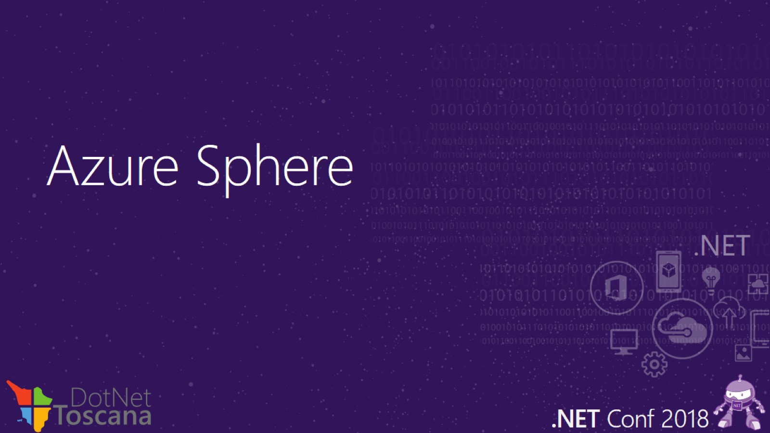
Azure Sphere

Slide 17
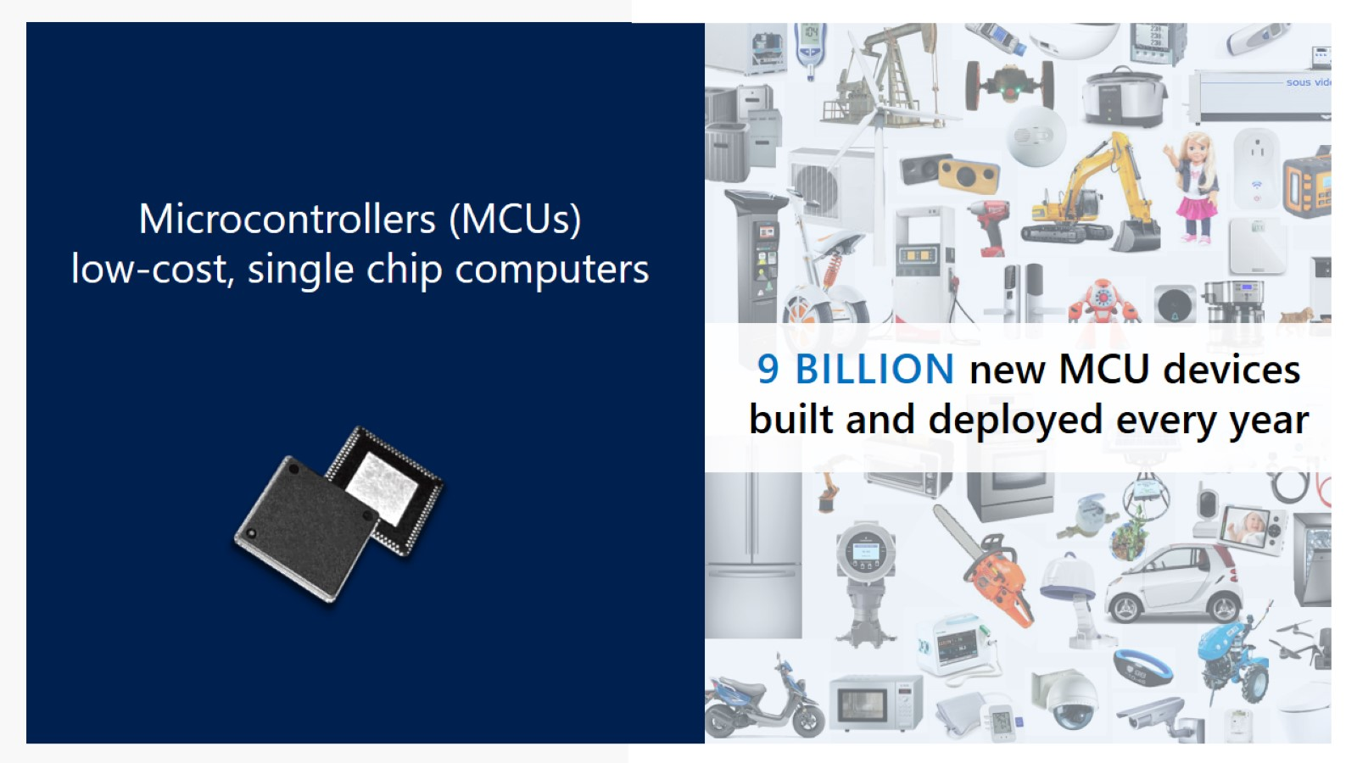

Slide 18
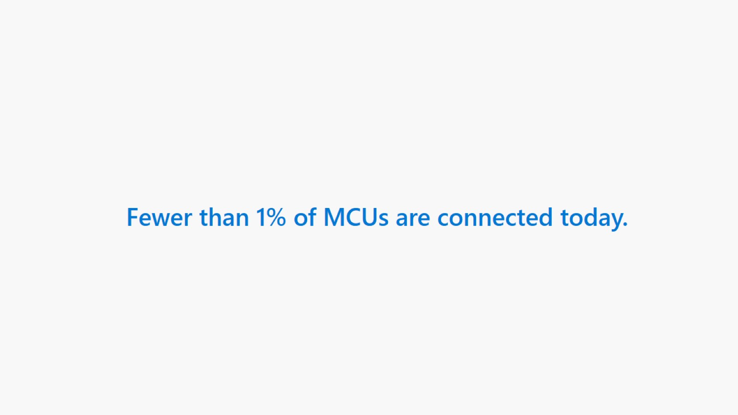

Slide 19
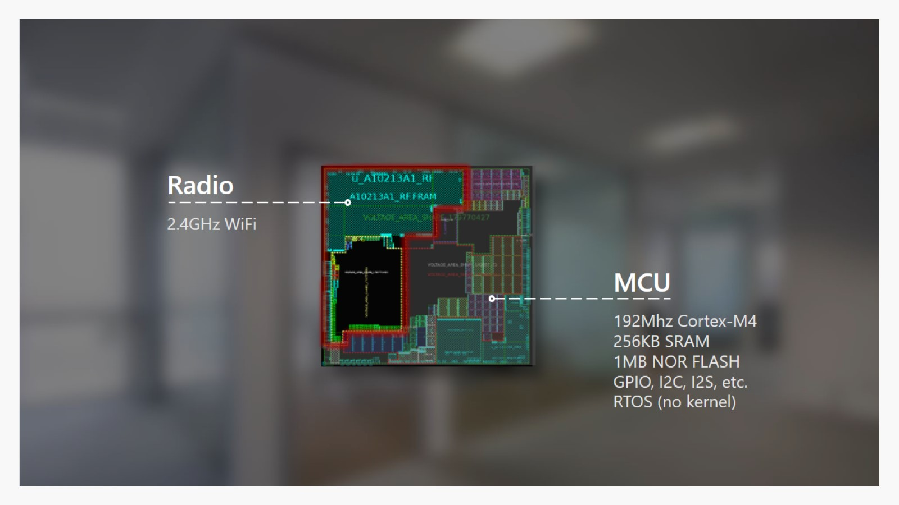

Slide 20
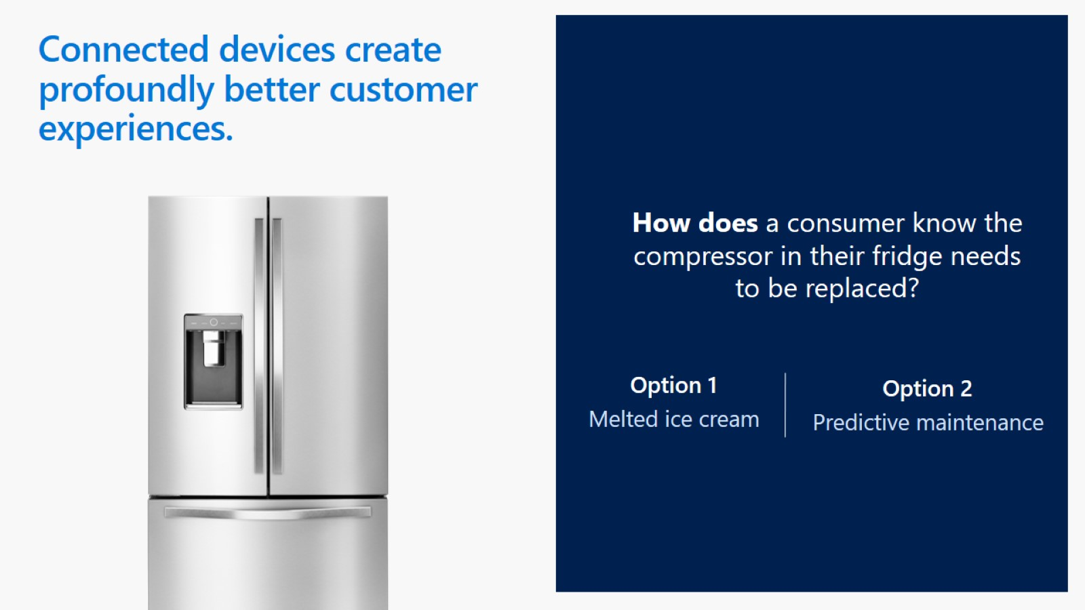

Slide 21


Slide 22
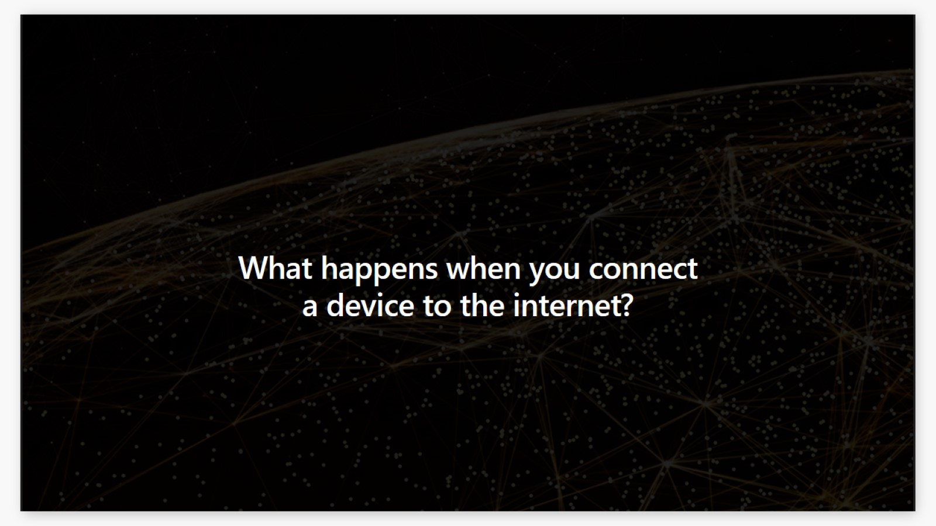

Slide 23


Slide 24
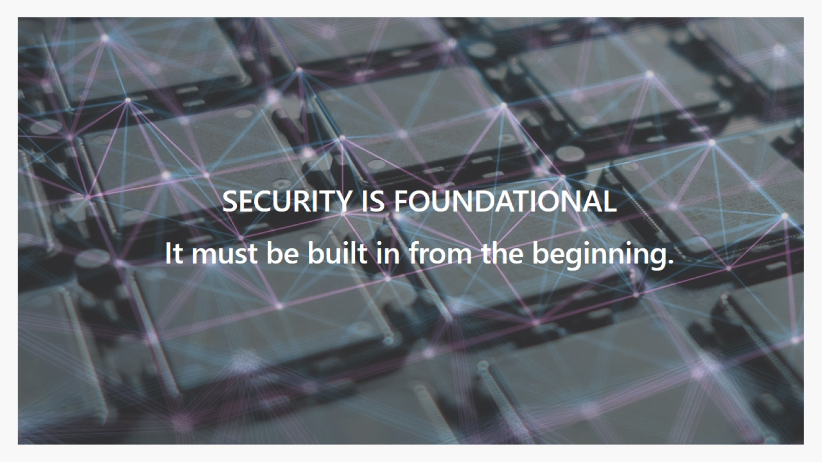

Slide 25
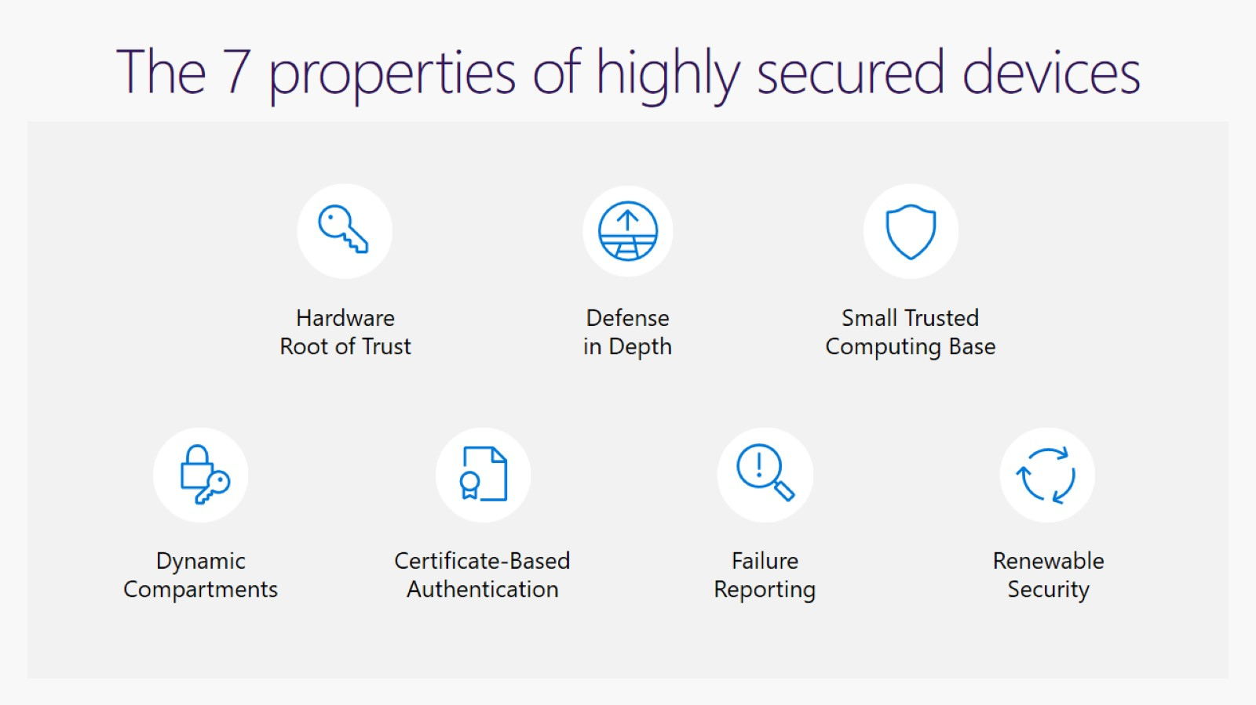
The 7 properties of highly secured devices

Slide 26
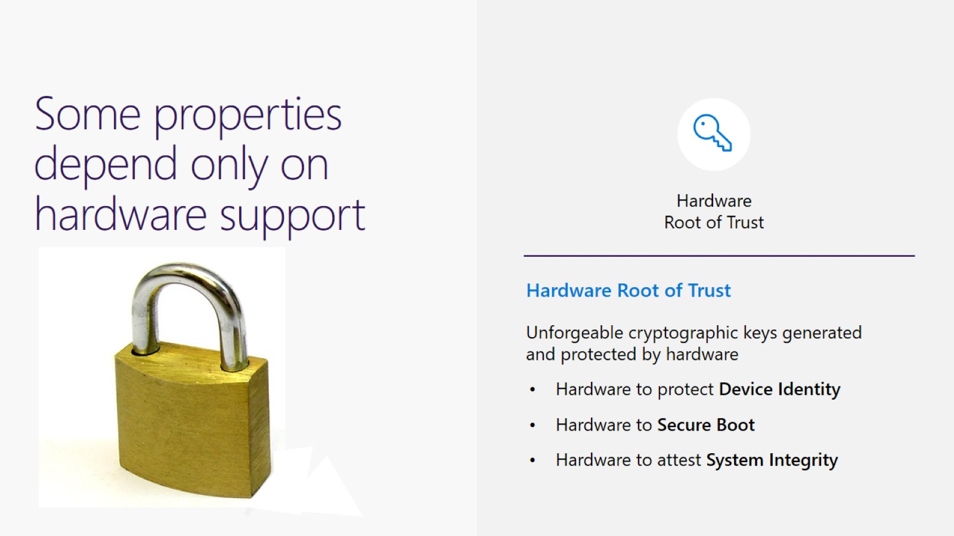
Some properties depend only on hardware support

Slide 27
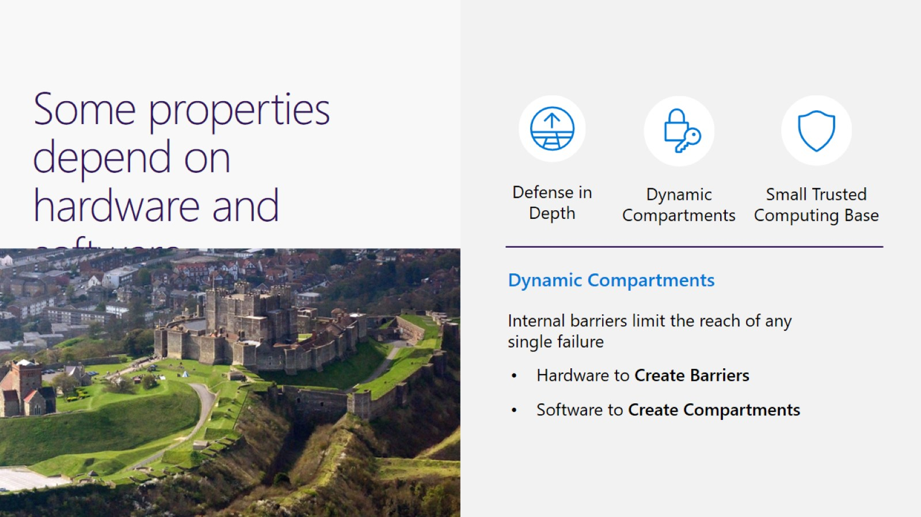
Some properties depend on hardware and software

Slide 28
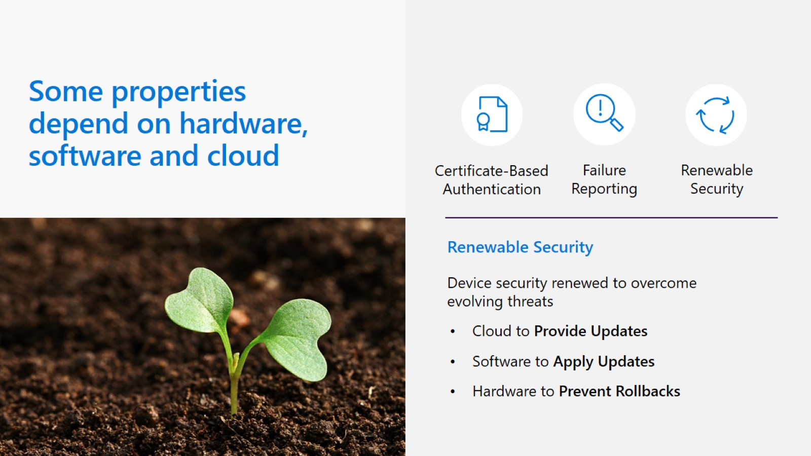

Slide 29
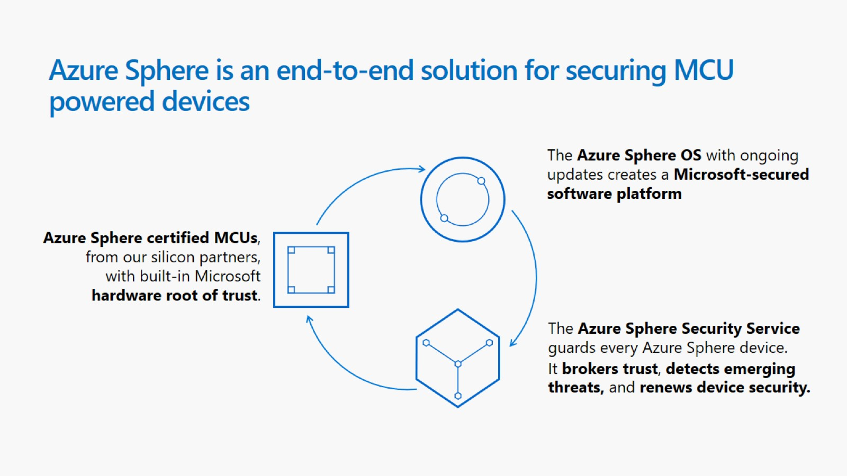
Azure Sphere is an end-to-end solution for securing MCU powered devices

Slide 30
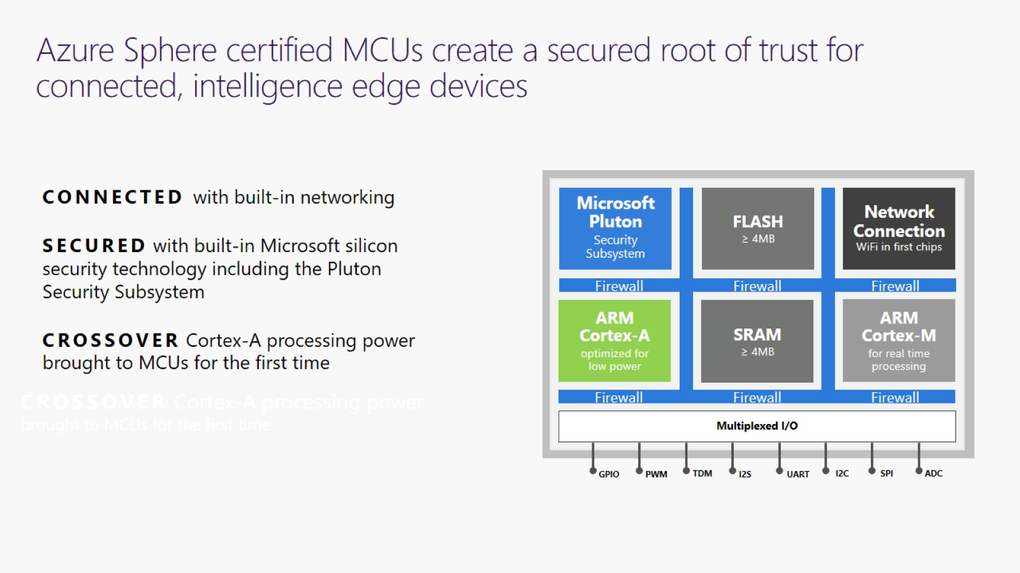
Azure Sphere certified MCUs create a secured root of trust for connected, intelligence edge devices

Slide 31
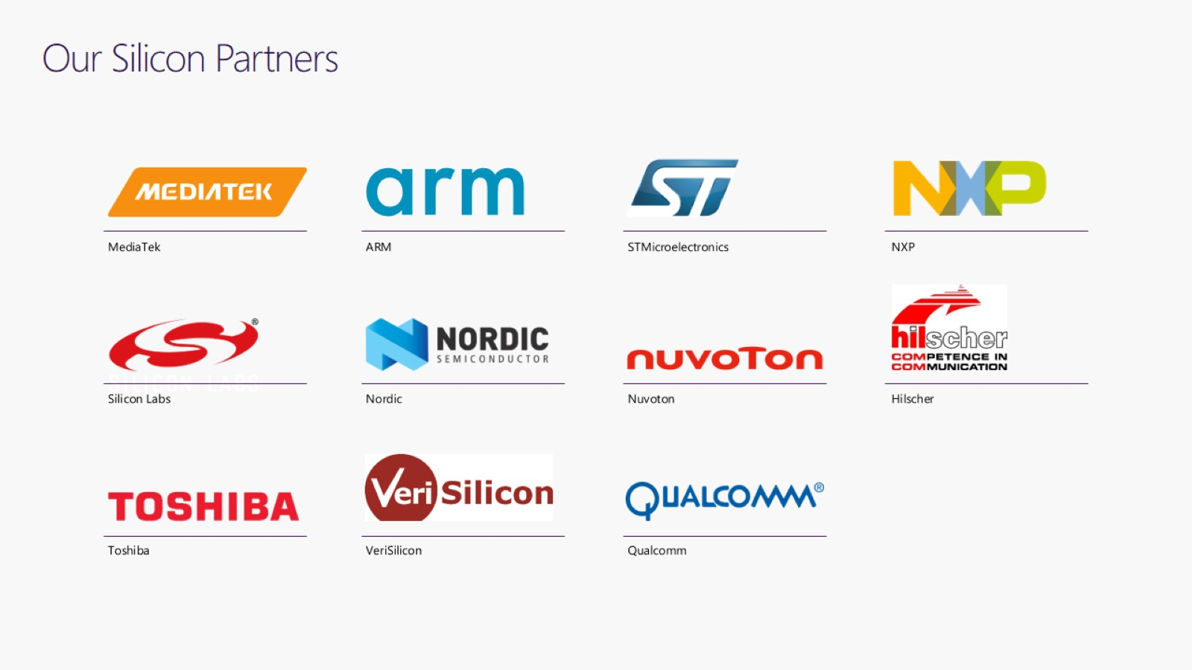
Our Silicon Partners

Slide 32
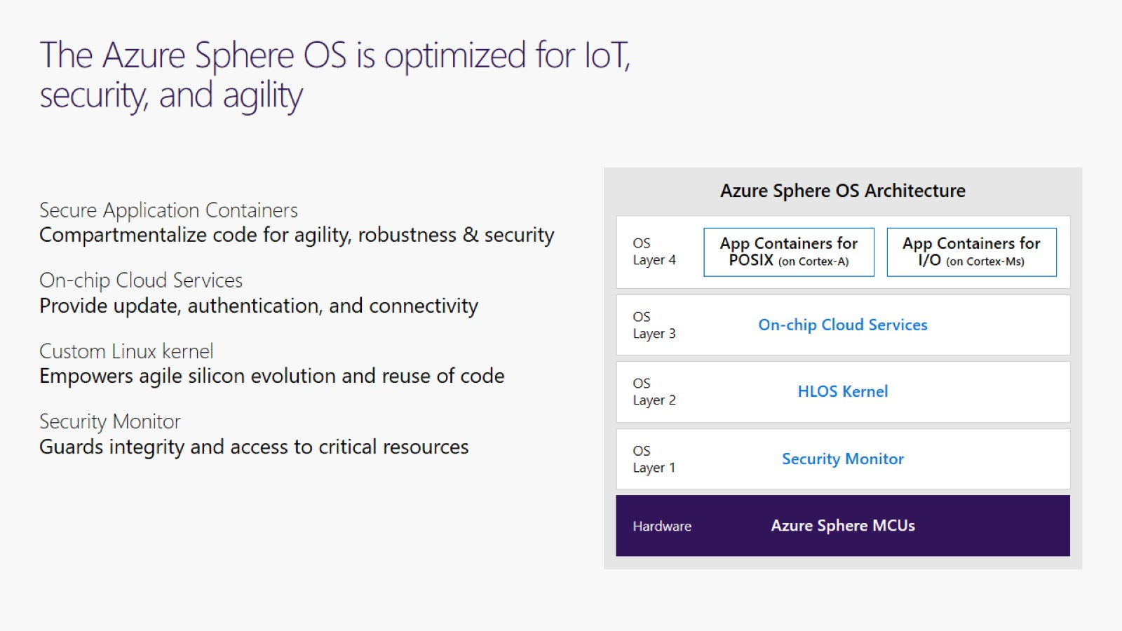
The Azure Sphere OS is optimized for IoT, security, and agility

Slide 33
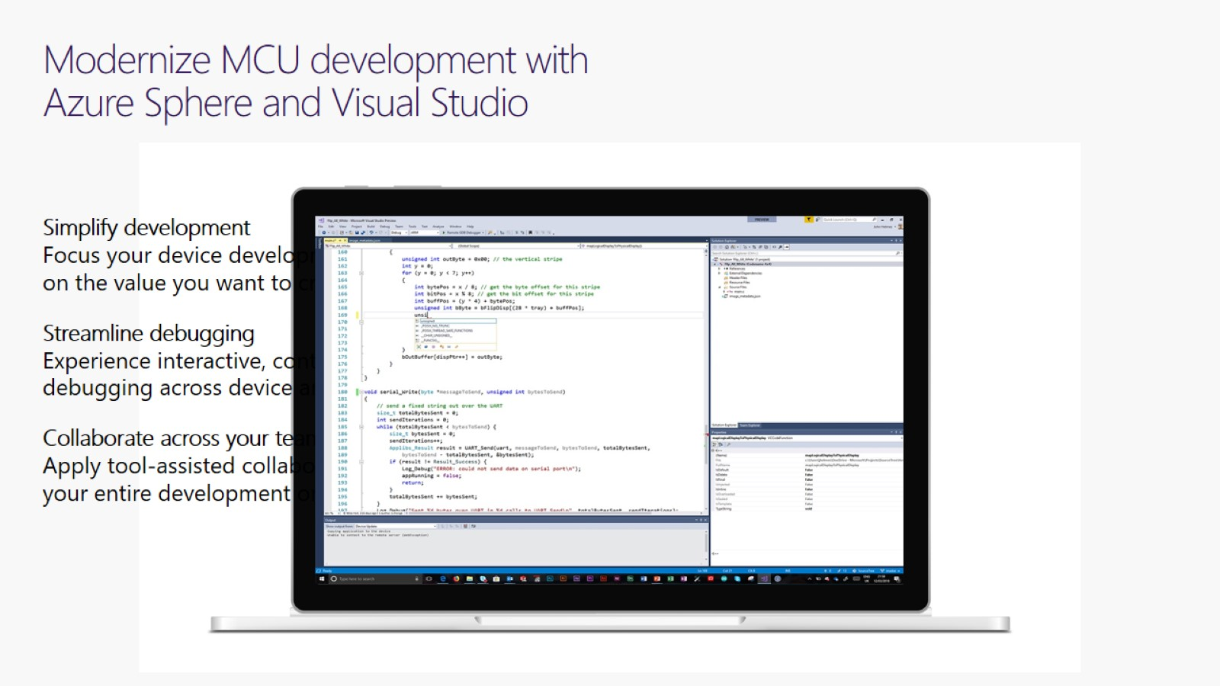
Modernize MCU development with Azure Sphere and Visual Studio

Slide 34
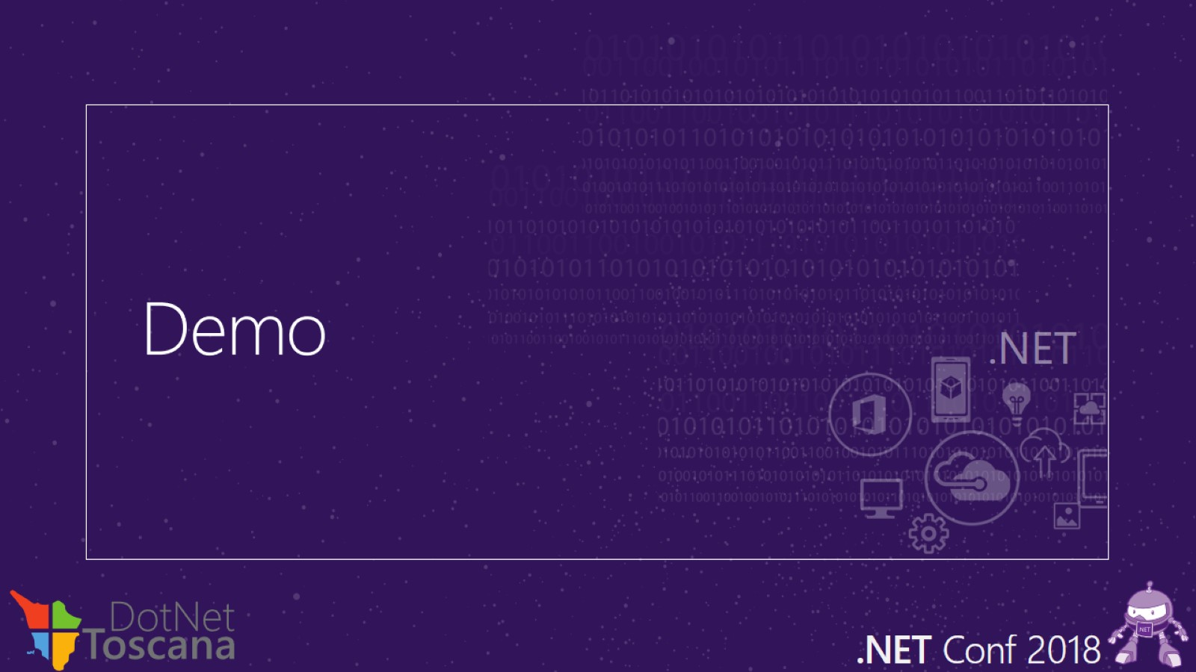
Demo

Slide 35
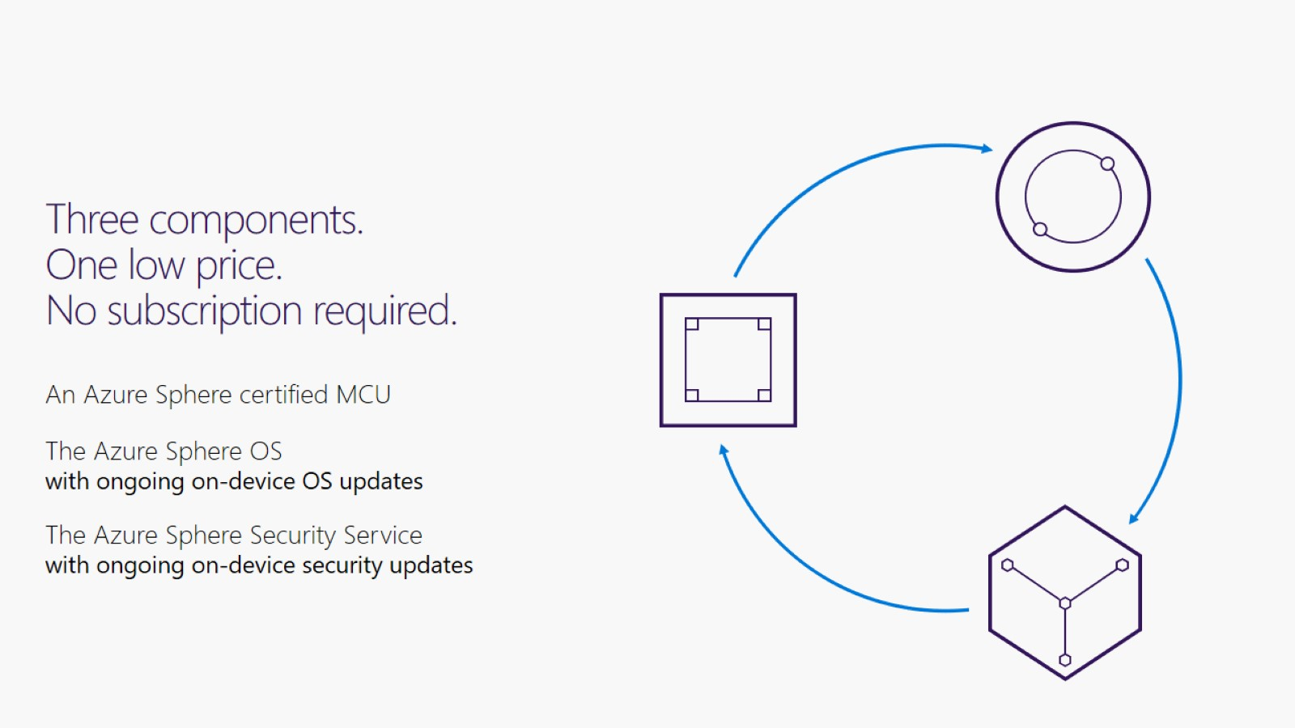
Three components. One low price. No subscription required.

Slide 36

Azure Sphere is open

Slide 37
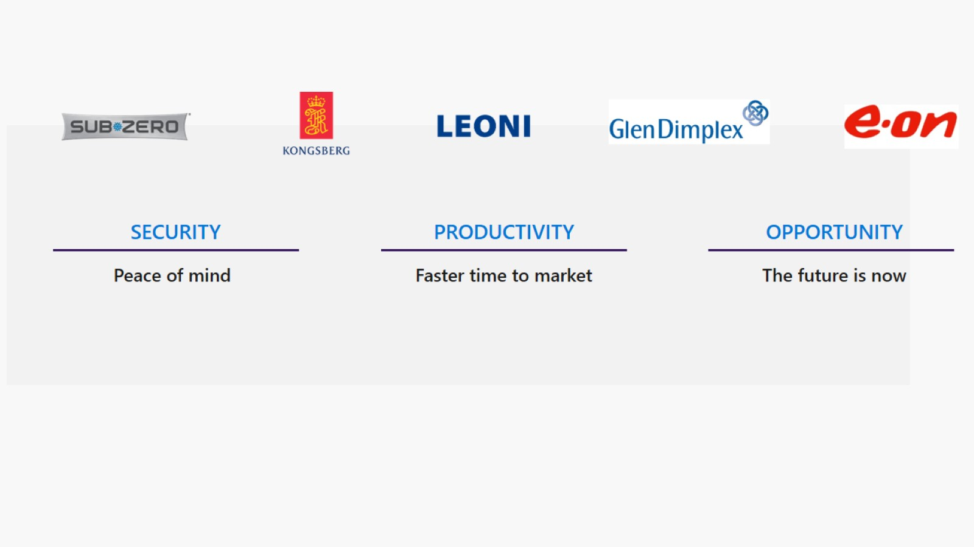

Slide 38
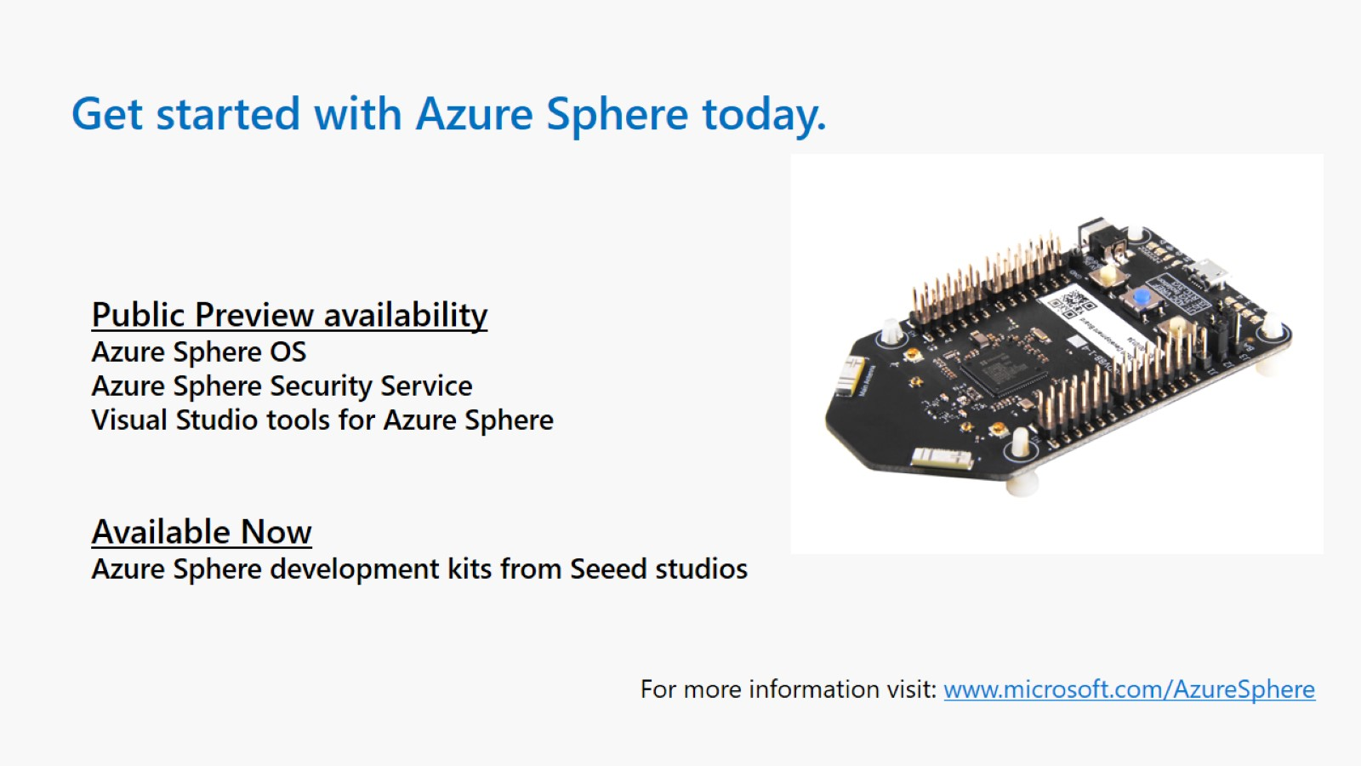

Slide 39
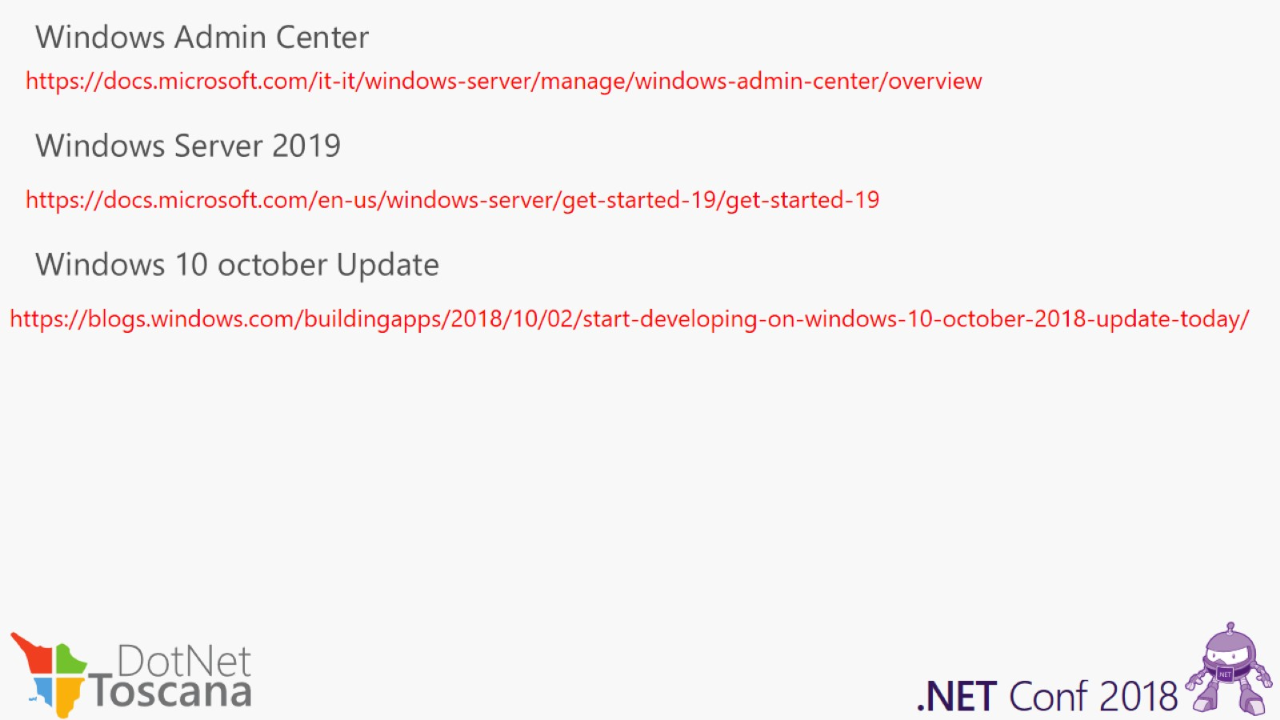

Slide 40
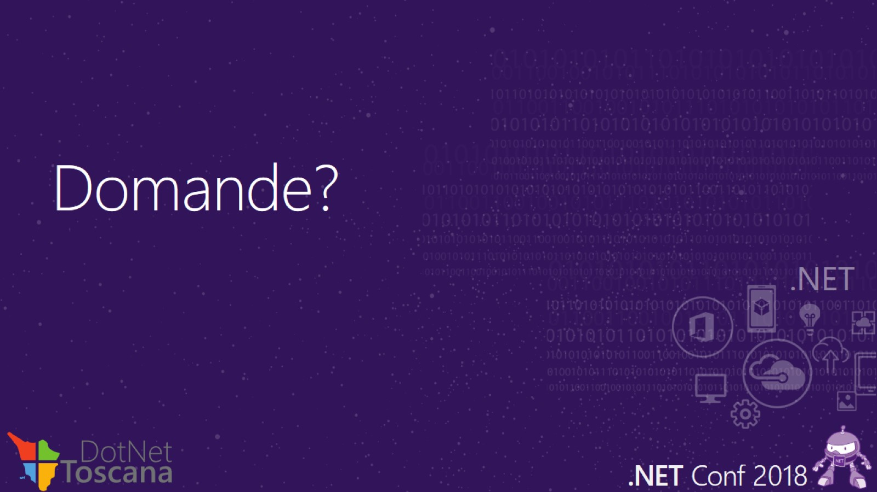
Domande?

Slide 41

Grazie!

Slide 42
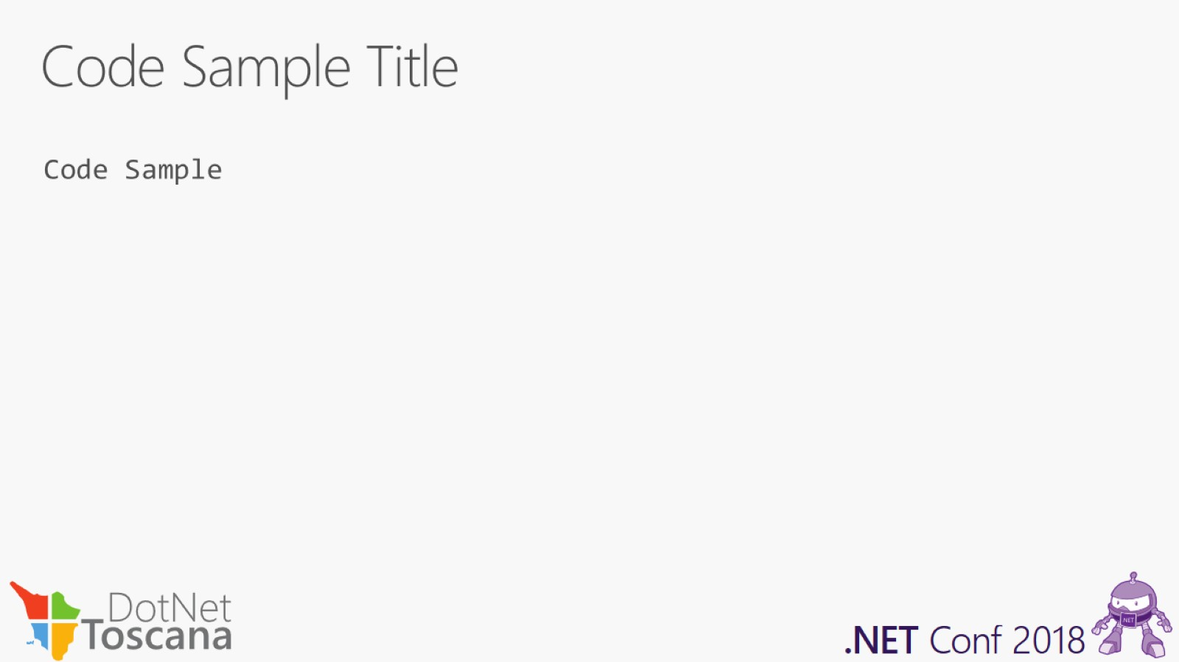
Code Sample Title

